Slide 1
Hiring Process Analytics Statistics
By-Ayush Wankhede

Slide 2
agenda
Project Description 3
Approach 4
Tech-Stack Used 5
Insights 10
Result 13

Slide 3
Project Description
The hiring process is the foundational and crucial part of a business. The MNCs learn about the key underlying trends relating to the hiring process here. Before hiring freshmen or anybody else, a corporation should consider trends such as the number of rejections, interviews, sorts of jobs, openings, etc. So, there is a chance for a Data Analyst employment here as well .
As a data analyst, it is your responsibility to examine these trends and derive insights that the hiring department may use.
You are a lead data analyst at an MNC like Google, and your employer has given you access to the recruiting history data and requested you to respond to some questions.

Slide 4
Approach
Based on information from a company's dataset that contains information about individuals who applied for a specific position within a department. We must apply our statistical expertise, employ various Excel formulas, and make the appropriate business-related conclusions.
Use the EDA steps listed below.
having knowledge of data columns
examining missing data
combining columns that have several categories
looking for anomalies
Taking out anomalies
drawing data overview

Slide 5



Tech-Stack Used
Excel
PowerPoint
Google drive

Slide 6
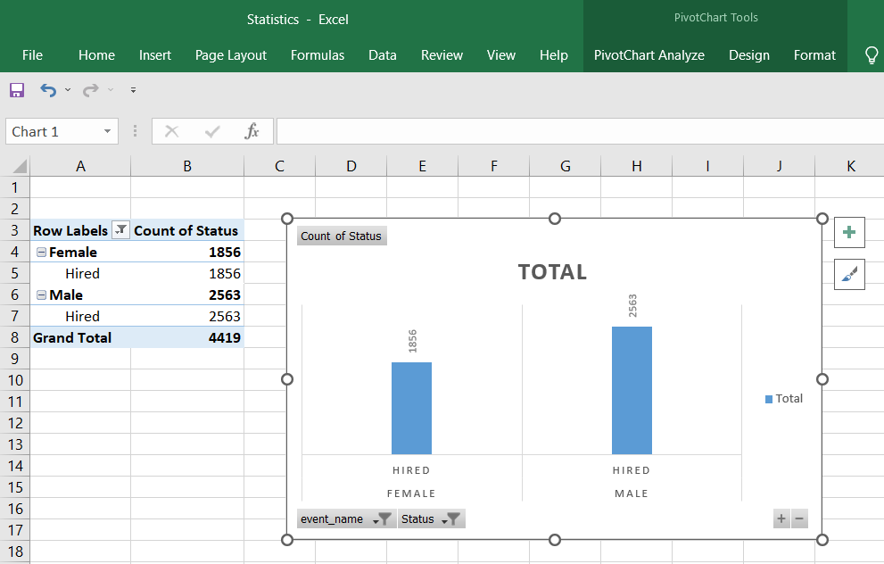
insight
After downloading the dataset, use Excel or Google Sheets to answer the below questions:
Hiring: Process of intaking of people into an organization for different kinds of positions.
Your task: How many males and females are Hired ?

Slide 7
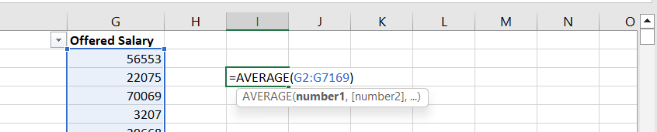
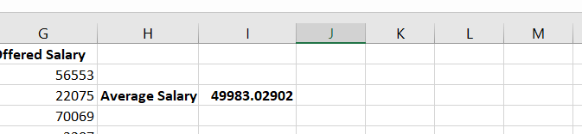
B.Average Salary: Adding all the salaries for a select group of employees and then dividing the sum by the number of employees in the group.
Your task: What is the average salary offered in this company ?

Slide 8
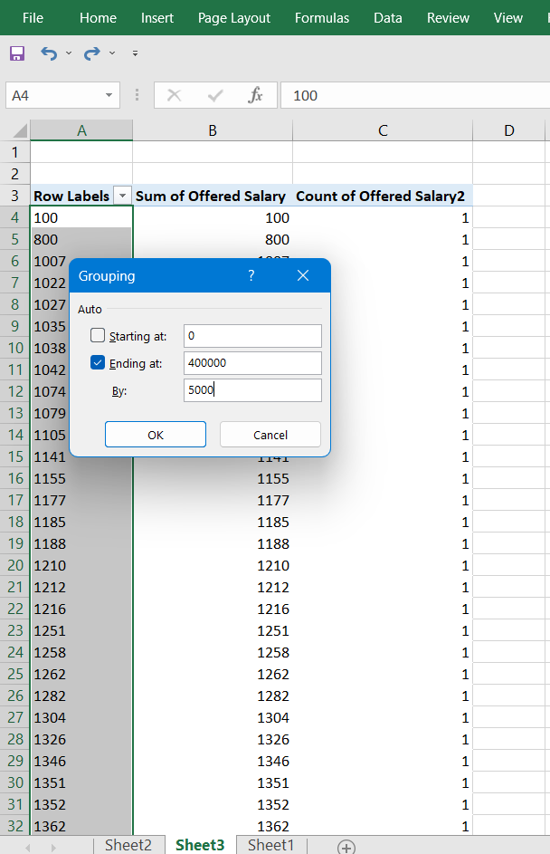
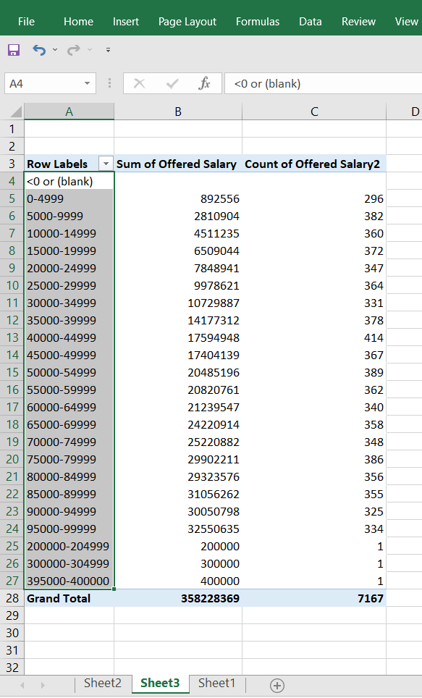
C.Class Intervals: The class interval is the difference between the upper class limit and the lower class limit.
Your task: Draw the class intervals for salary in the company ?

Slide 9
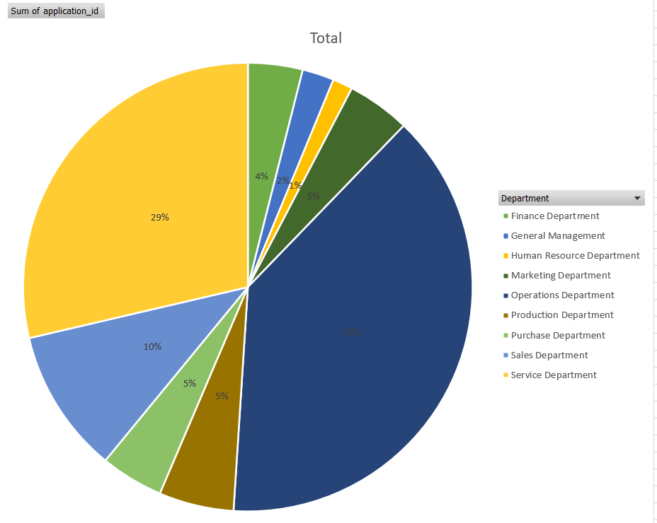
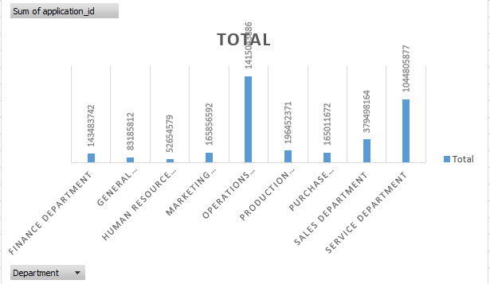
D.Charts and Plots: This is one of the most important part of analysis to visualize the data. Your task: Draw Pie Chart / Bar Graph ( or any other graph ) to show proportion of people working different department ?

Slide 10
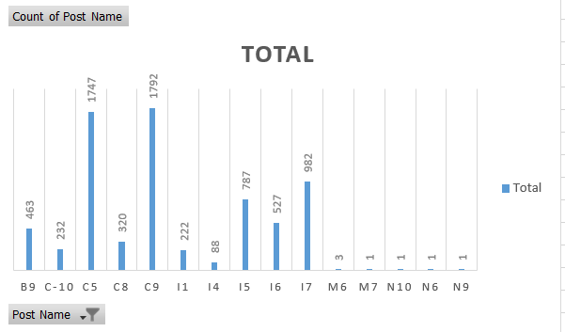
E.Charts: Use different charts and graphs to perform the task representing the data. Your task: Represent different post tiers using chart/graph?

Slide 11
Result
Excel is a powerful tool for conducting studies and what-if scenarios. To calculate the various conditions, you employ formulas in cells with one or more input cells. You can utilize the controls from the Forms toolbar or the Control toolbox to make working with various values and/or options easier. Your models become simpler to use when these controls are used properly.
The controls also give you the ability to simplify data entry while simultaneously enhancing data quality by lowering the possibility of incorrect entries. The Forms controls are my recommendation for "day-to-day" use.

Slide 12
thank you

